Slide 1
Chapter 1
The World of Communication

Slide 2
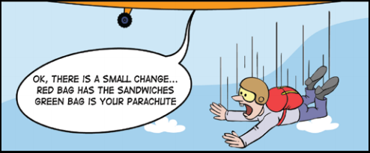
Why Study Communication?
Improve our skills
Intrapersonal
Interpersonal
Group
Help us make sense of what happens in our lives
Increase our personal impact
Source: http://change.walkme.com/change-management-cartoon-the-importance-of-early-communication/

Slide 3
Defining Communication
Communication: A systemic process in which people interact with and through symbols to create and interpret meanings.
Example 1: https://youtu.be/Lnw0ylrtE6k?t=21
Example 2: https://www.youtube.com/watch?v=TSZMjtvL6Vc
Example 3: https://www.youtube.com/watch?v=nXuvzsIf1oE
Are these scenes surprising or unexpected? If surprising, why do you think so? If it was not surprising, how did you know what was going to happen?

Slide 4
Features of Communication
Communication: A systemic process in which people interact with and through symbols to create and interpret meanings.
Process
Ongoing and continuously in motion
Systemic
Occurs in a system of interrelated parts that affect one another
Occurs in fixed, standardized ways that allow successful recognition and reciprocation
Symbols
All language and many nonverbal behaviors—anything that abstractly signifies something else

Slide 5
Levels of Communication
Communication: A systemic process in which people interact with and through symbols to create and interpret meanings.
Meanings
The significance we bestow on phenomena—what they signify to us
Content Level – literal, denotative
Relationship Level – relationships between communicators

Slide 6
Values of Communication
Personal Identity and Health
We gain personal identity as we communicate with others
Communication directly influences our physical and emotional well-being
Relationship
the primary way we connect with others
Used to solve problems and resolve conflict
Used for self-disclosure
Professional Values
Communication skills are closely linked to professional success
Cultural Values
Crucial for participation is society (or politics) and for interacting with those from other cultures successfully
michaeljung/shutterstock.com

Slide 7
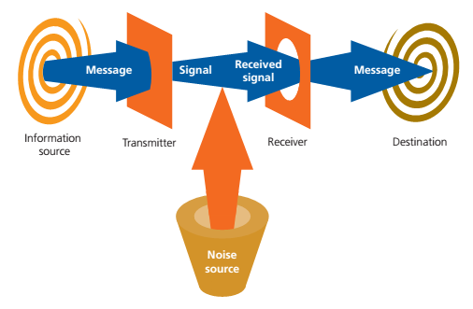
Models of Communication: Linear
Cengage Learning

Slide 8
Linear Model of Communication
A one-way process in which one person acts on another person
One person attempts to transmit meaning through symbols to another
Communication attempt is either successful or unsuccessful → once message has either succeeded or failed, communication is over
Noise
Anything that interferes with the intended communication
Includes: physical (obstructions, literal noise); psychological (emotions, moods, focus); physiological (physical ability, comfort level)
Too simplistic for most scenarios (e.g. face to face communication or email); however, is applicable to mass media (TV, radio, newspapers, etc.), in which communication is one-directional, with the receiver being unable to respond directly

Slide 9
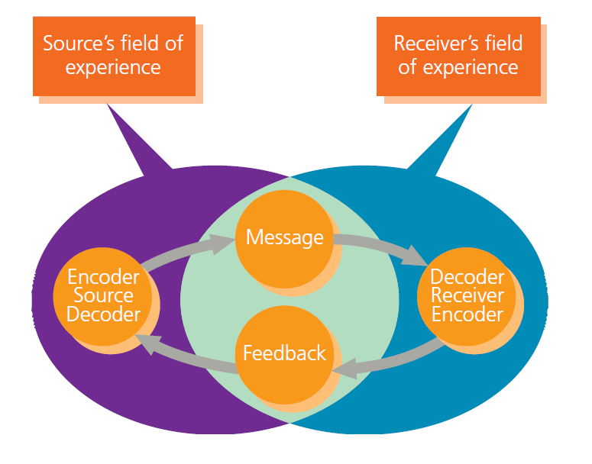
Models of Communication: Interactive
Cengage Learning

Slide 10
Interactive Models of Communication
In this model receivers respond to senders → a circular model (like playing catch) that best reflects distance communication, such as email, text messaging, etc., where responses are not immediate
Senders listen to receivers
Feedback: the message one sends to the intial sender as a response
Verbal or nonverbal: includes words, but also gestures or facial expressions
Intentional or unintentional: even unintentional signals (e.g. looking bored) communicate meaning as feedback
Create and interpret within fields of experience: includes anything that might influence the communication process: shared space (physical or digital), language, nationality, culture, even socio-economic status
In any communication exchange, certain fields of experience must overlap for it to be successful (e.g. being in the same space and having some common symbols to use to communicate), but many aspects of our fields of experience can be different

Slide 11
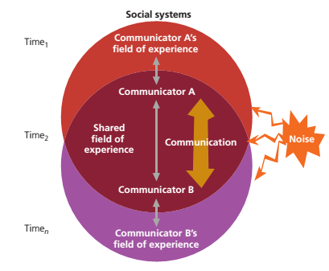
Models of Communication: Transactional
Cengage Learning

Slide 12
Transactional Model of Communication
People often simultaneously send and receive messages
Communication changes over time
Communication is subject to potential interference from noise
Communication occurs within systems (shared contexts and personal contexts)
This model is the most accurate representation of face-to-face communication, in which each party is constantly communicating with each other through words, gestures, facial expressions, etc.
In face-to-face communication, communication is constant, only ending when one physically leaves the exhange

Slide 13
Breadth of the Field
Communication takes place in specific contexts – determined by the medium of communication and number of people involved – which often overlap with fields of the study of communication:
Intrapersonal Communication : within oneself
Interpersonal Communication: between 2 or more parties, often in shared space
Group Communication: small groups or teams
Mass Communication and Digital Media: Traditional media (TV, newspaper, radio, etc.) and modern interactive media
Public Communication: One person speaking to larger group

Slide 14
Breadth of the Field
Some fields of the study of communication focus on specific professional contexts or interpersonal situations
Here, the focus is less on the media or the number of people involved, and more on the traits of the specific context:
Organizational Communication: within companies or fixed organizations
Health Communication : Related to health care
Intercultural Communication: between those of different cultures (includes race, ethnicity, religion, nationality, community, etc.)

Slide 15
Unifying Themes
Symbols
Meaning
Critical Thinking
Ethics and Communication
Pressmaster/Shutterstock.com

Slide 16
Careers in Communication
Education
Media Production, Analysis, and Criticism
Training and Consulting
Human Relations and Management
Research

Slide 17
Digital Media and Communication
Value
Maintaining personal relationships through social media
Job search
Civic engagement
Drawbacks
Lack of contextual cues
Delayed feedback
Missed meaning

